Slide 1
Clustering Bonds according to their market liquidity
Yiting Yuan, Ayushee Jain, Sumukh Madhusudhan, Nasim Zarei

Slide 2

Table of Contents
Securities
2. Market Liquidity
3. Bonds
4. Data extraction
5. K-Means Clustering
6. Conclusion

Slide 3
Security

Slide 4

Security
Securities are fungible and tradable financial instruments used to raise capital in public and private markets.
Four types:
Equity security — ownership
Debt security—essentially loans
Hybrids security—combine debt and equity
- Derivative Security

Slide 5

Equity Securities
Ownership interest held by shareholders in an entity
Realized in the form of shares of capital stock
Holders:
Not entitled to regular payments
Dividends, able to profit from selling the securities
Control of the company on a pro rata basis, via voting rights

Slide 6

Debt Securities
Borrowed money that must be repaid, with terms: size of the loan, interest rate, and maturity or renewal date
Example:
Government and corporate bonds, notes
Holders:
Regular payment of interest and repayment of principal
Not include voting rights

Slide 7
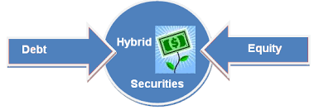
Hybrid Securities
Examples:
Convertible bonds: Bonds that can be converted into shares of common stock in the issuing company
Preference shares: Company stocks whose payments of interest, dividends, or other returns of capital can be prioritized over those of other stockholders

Slide 8

Derivative Securities
Financial contract whose price is determined by the value of some underlying asset
Example:
Option: Financial contracts that grant the holder the right (but not the obligation) to buy or sell an underlying asset at a predetermined price in the future
Call options, which gain value if the underlying asset appreciates,
Put options, which gain value when the underlying asset loses value.

Slide 9
Option
Suppose you are interested in the stock of Company XYZ, currently priced at $50 per share. Believing that the stock price may rise in the next three months, but acknowledging uncertainty, you decide to purchase a call option for risk management.
You buy a three-month call option for XYZ Company with a strike price of $55, paying an option premium of $3.
Now, there are two possible scenarios:
1）Stock Price Rises to $60 - exercise your option - sell it on the market for $60 - profit of $5 per share - net profit is $2 per share
2）Stock Price Falls or Remains Flat - not to exercise your option - lose the $3 option premium paid

Slide 10
Market Liquidity

Slide 11

What is market liquidity?
Liquidity refers to the ease with which an asset, or security, can be converted into ready cash without affecting its market price.
The more liquid an asset is, the easier and more efficient it is to turn it back into cash. Less liquid assets take more time and may have a higher cost.

Slide 12
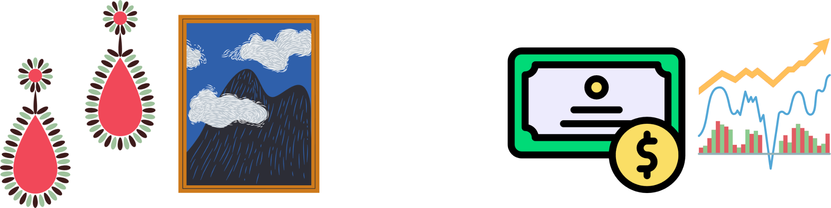
Why is Market Liquidity Important?
If markets are not liquid, it becomes difficult to sell or convert assets or securities into cash.
Companies also must hold enough liquid assets to cover their short-term obligations like bills or payroll; otherwise, they could face a liquidity crisis, which could lead to bankruptcy.

Slide 13
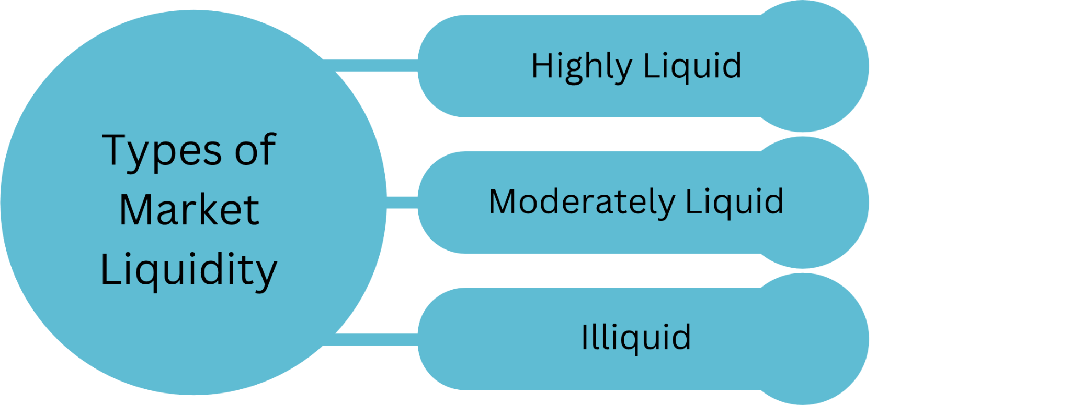

Slide 14
Liquidity Ratios in Financial Analysis
Current Ratio: Measures current assets against current liabilities.
Formula: Current Ratio = Current Assets ÷ Current Liabilities
Quick Ratio (Acid-Test Ratio): Excludes less liquid assets like inventories.
Formula: Quick Ratio = (Cash + Short-Term Investments + Accounts Receivable) ÷ Current Liabilities
Cash Ratio: The most stringent, assessing liquid assets strictly as cash or equivalents.
Formula: Cash Ratio = Cash and Cash Equivalents ÷ Current Liabilities

Slide 15
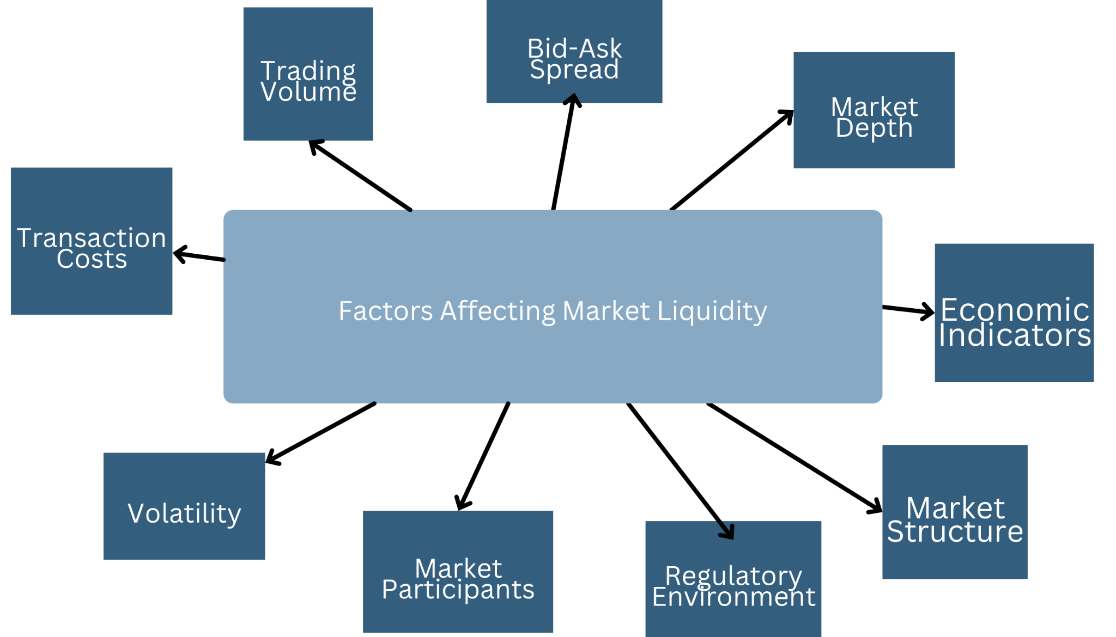

Slide 16
Trading Volume:
Higher trading volumes generally contribute to greater liquidity as there are more buyers and sellers in the market.
Bid-Ask Spread:
A narrower bid-ask spread (the difference between the buying and selling prices of an asset) typically indicates higher liquidity. A wider spread may indicate lower liquidity.
Market Depth:
Market depth refers to the quantity of buy and sell orders at various price levels. A deep market with a large number of orders can enhance liquidity.
Transaction Costs:
Lower transaction costs, such as commissions and fees, can encourage more trading activity and enhance liquidity.
Economic Indicators:
Economic factors, such as interest rates, inflation, and economic growth, can impact investor confidence and influence liquidity.
Global Events:
Geopolitical events, economic crises, or other global developments can create uncertainty and impact liquidity as investors may become more risk-averse or seek safe-haven assets.

Slide 17
Bonds & Data Extraction

Slide 18

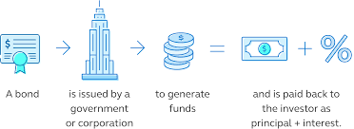
What is bond?
A bond is a fixed income instrument that represents a loan made by an investor to a borrower (typically corporate or governmental). Bonds are used by companies, municipalities, states, and sovereign governments to finance projects and operations. Owners of bonds are debtholders, or creditors, of the issuer.
Bond details include the end date when the principle of the loan is due to be paid to the bond owner and usually include the fix interest payments made by the borrower.

Slide 19
Which country do you think is in the first place in bond market?
Germany
US
India
China
Russia
Iran

Slide 20
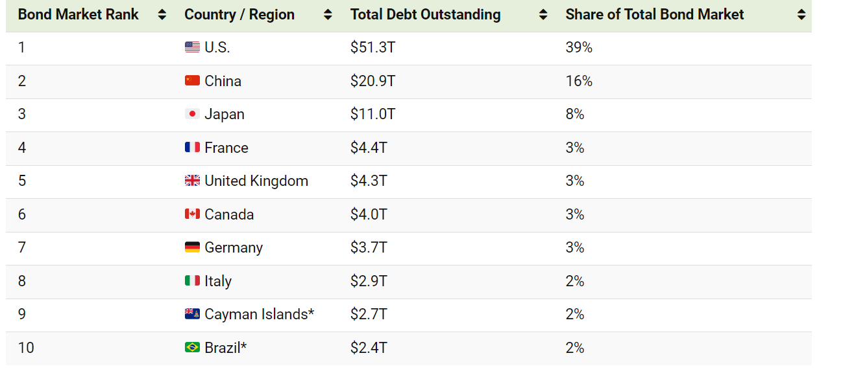
the world’s top bond markets (1-10)

Slide 21
the world’s top bond markets (10-20)
Bond Market Rank | Country / Region | Total Debt Outstanding | Share of Total Bond Market
11 | 🇰🇷 South Korea* | $2.2T | 2%
12 | 🇦🇺 Australia | $2.2T | 2%
13 | 🇳🇱 Netherlands | $1.9T | 1%
14 | 🇪🇸 Spain | $1.9T | 1%
15 | 🇮🇳 India* | $1.3T | 1%
16 | 🇮🇪 Ireland | $1.0T | 1%
17 | 🇲🇽 Mexico* | $1.0T | 1%
18 | 🇱🇺 Luxembourg | $0.9T | 1%
19 | 🇧🇪 Belgium | $0.7T | >1%
20 | 🇷🇺 Russia* | $0.7T | >1%

Slide 22
Why Bonds?
Diversity in Issuers: Bonds are issued by various entities, including governments, corporations and etc.
Unique Market Dynamics: Bond markets have their own set of dynamics and factors influencing liquidity.
Regulatory Environment: The regulatory environment for bonds can differ from that of other securities.
Market Impact of Economic Events: Economic events and indicators may have varying effects on different types of securities. Focusing on bonds allows you to explore how economic events, such as inflation or economic downturns, influence liquidity in fixed-income markets.

Slide 23
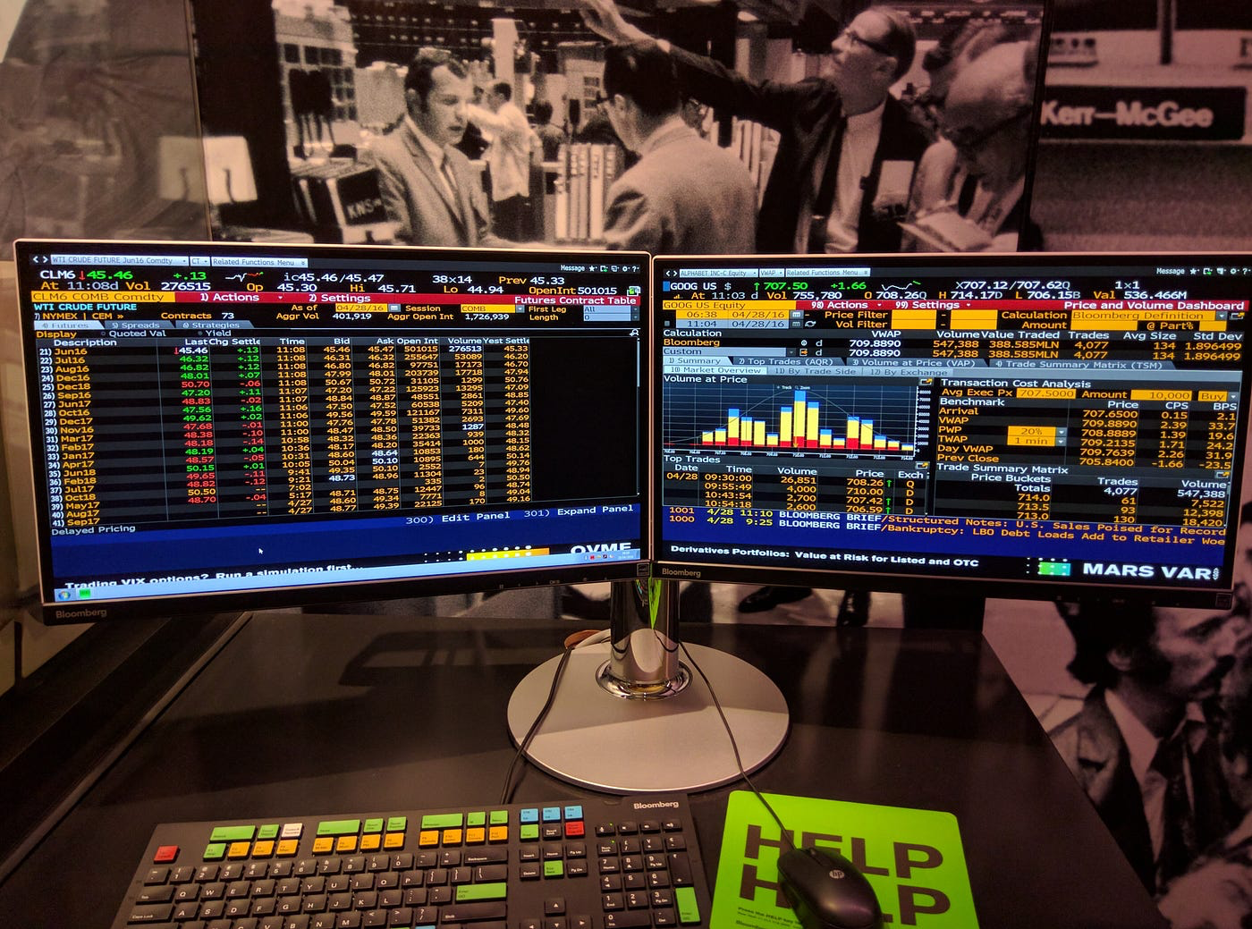
Bloomberg Terminal
The Bloomberg Terminal is a computer software system provided by the financial data vendor Bloomberg that enables professionals in the financial service sector and other industries to access Bloomberg Professional Services through which users can monitor and analyze real-time financial transparent market data.
The financial data vendor’s proprietary computer system starts at $30,000 per user per year.

Slide 24
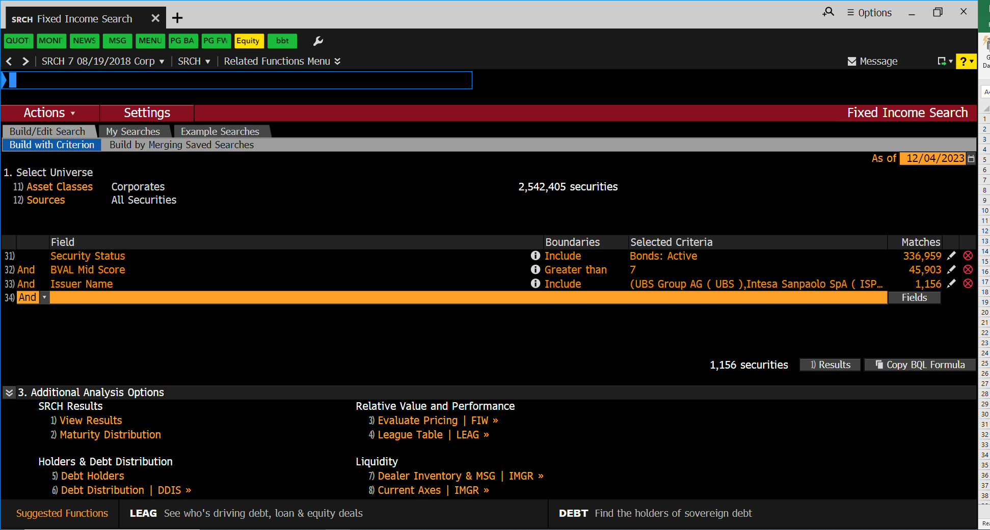

Slide 25
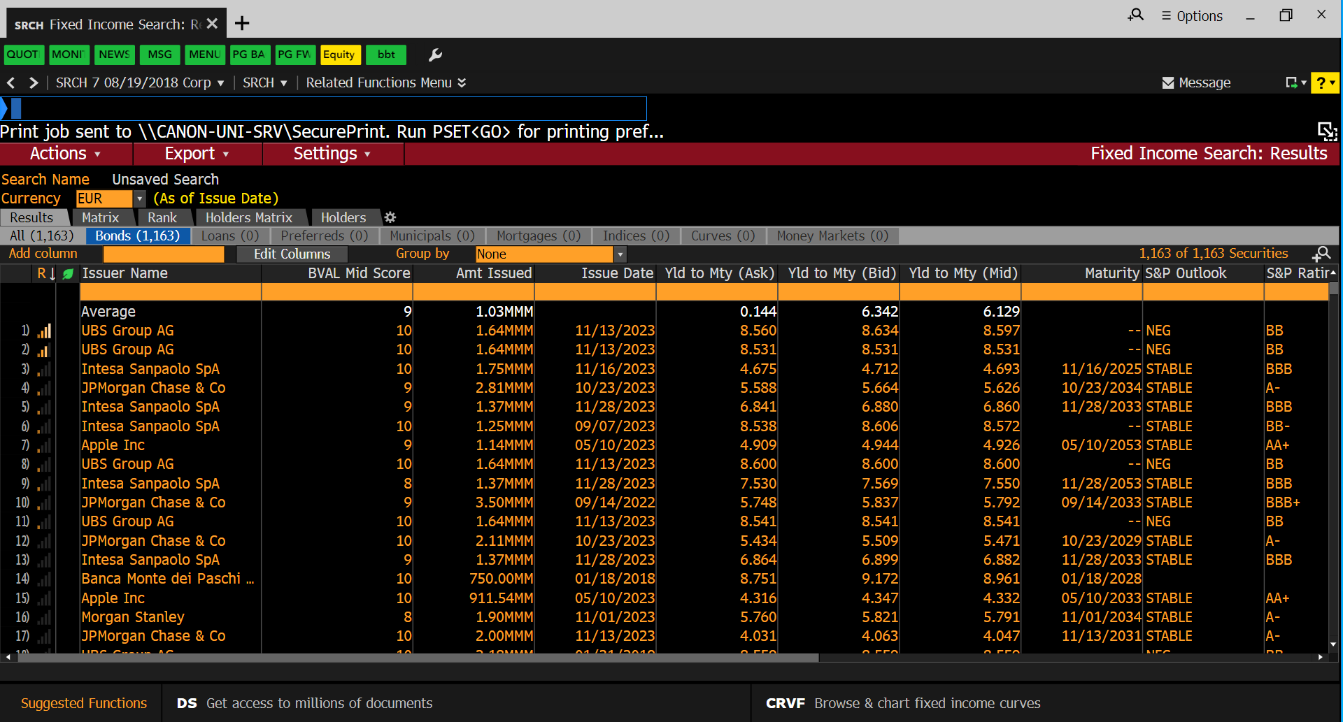

Slide 26
Here are the features that we have used:
Yld to Mty (Ask):
Significance: Represents the yield to maturity, offering insights into the expected return on investment.
Impact on Liquidity: Higher yields may attract a broader investor base, influencing market liquidity positively.
LQA Bid-Ask Spread:
Significance: Measures the difference between buying and selling prices, indicating trading costs.
Impact on Liquidity: A narrower bid-ask spread implies lower transaction costs, fostering higher liquidity and trader participation.

Slide 27
Market Cap:
Significance: Reflects the total market value of the security.
Impact on Liquidity: Larger market capitalization often correlates with increased liquidity, as larger securities tend to attract more market participants.
LQA Expected Daily Vol:
Significance: Represents the anticipated daily trading volume.
Impact on Liquidity: Higher expected daily volume signals active trading, suggesting greater liquidity and ease of buying or selling in the market.

Slide 28
Analysis

Slide 29


Data Preprocessing
Null Value Handling:
Observation: Identified null values in certain columns.
Treatment: Addressed null values in Yld to Mty (Ask), LQA Bid-Ask Spread, LQA Expected Daily Vol, and Market Cap using KNN imputation.
Column Derivation:
Derivation: Created derived columns like Yield Spread.
Purpose: Introduced additional features to capture specific aspects of market dynamics.
Standardization:
Reasoning: Ensured that features are on a similar scale for algorithms sensitive to scale differences (K-means).
Method: Applied StandardScaler to standardize features and enhance clustering performance.
‹#›

Slide 30
Data Preprocessing
Cluster Analysis:
Choice: Opted for clustering analysis to group securities based on market liquidity features.
Algorithm: Utilized K-means clustering for the analysis.
Correlation Analysis:
Objective: Investigated correlations among selected features.
Outcome: Explored feature relationships to identify potential redundancies or strong correlations, removed redundant features with very high correlation
‹#›

Slide 31
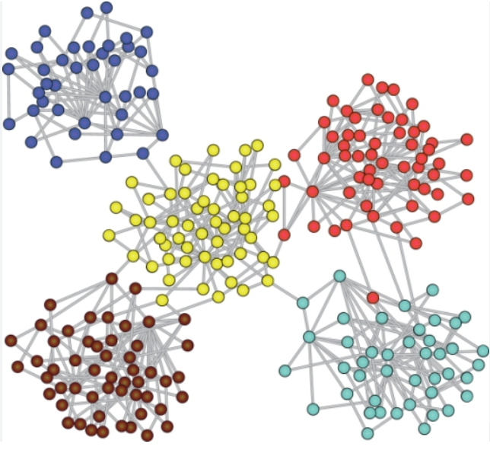
CLUSTERING
Clustering analysis is a type of unsupervised machine learning technique that involves grouping similar data points into clusters or segments based on inherent patterns or similarities within the data.
The primary objective is to discover inherent structures within the dataset without explicit guidance from labeled outcomes.
In clustering, the algorithm seeks to identify natural groupings or clusters of data points based on certain criteria.

Slide 32
A few types of Clustering algorithms
Hierarchical Clustering:
Builds a tree-like hierarchy of clusters by successively merging (agglomerative) or splitting (divisive) clusters based on the similarity between data points.
DBSCAN (Density-Based Spatial Clustering of Applications with Noise):
Identifies clusters as dense regions separated by areas of lower point density. Points not belonging to any cluster are considered noise.
Mean Shift Clustering:
Locates cluster centroids by iteratively shifting the mean of data points towards the mode of the data's probability distribution.

Slide 33
K Means Clustering
K-Means clustering is a partitioning method that aims to divide a dataset into K distinct clusters.
Key Steps of K-Means Clustering:
Initialization:
Randomly select K data points from the dataset as the initial cluster centroids.
These centroids represent the center of each cluster.
Assignment:
Assign each data point to the cluster whose centroid is closest Euclidean distance.
The data points are assigned to the cluster that minimizes the sum of squared distances between the data point and the cluster centroid.
Update Centroids:
Recalculate the centroids of the clusters by taking the mean of all data points assigned to each cluster.
The new centroids become the center points for the next iteration.
Repeat:
Repeat the assignment and centroid update steps iteratively until convergence or a predefined number of iterations.
Convergence occurs when the centroids no longer change significantly.

Slide 34
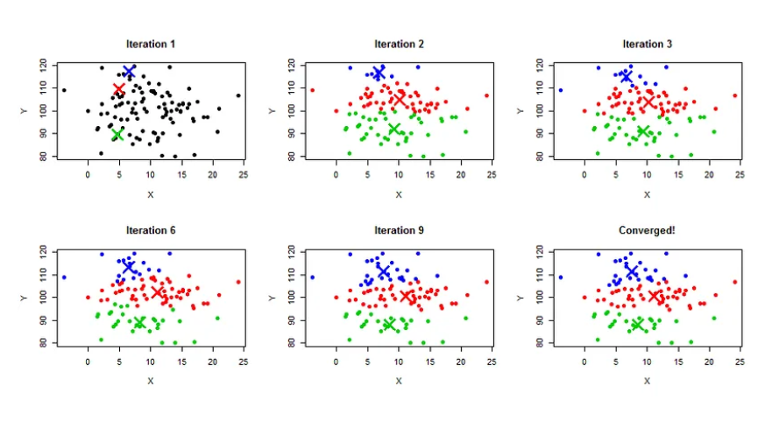
Types of Clustering
1. Hierarchical Clustering:
Builds a tree-like hierarchy of clusters by successively merging (agglomerative) or splitting (divisive) clusters based on the similarity between data points.
2. DBSCAN (Density-Based Spatial Clustering of Applications with Noise):
Identifies clusters as dense regions separated by areas of lower point density. Points not belonging to any cluster are considered noise.
3. Mean Shift Clustering:
Locates cluster centroids by iteratively shifting the mean of data points towards the mode of the data's probability distribution.

Slide 35
Characteristics of K-Means Clustering
Centroid-Based: K-Means is a centroid-based clustering algorithm where each cluster is represented by its centroid.
Sensitivity to Initial Centroids: The algorithm's final results can be influenced by the initial selection of centroids. It is common to run the algorithm multiple times with different initializations and choose the best result.
Scalability: K-Means is scalable and efficient, making it suitable for large datasets.
Assumes Spherical Clusters: K-Means works well when clusters are roughly circular or spherical and have similar sizes. It may struggle with irregularly shaped or differently sized clusters.
Requires Predefined K: The number of clusters (K) must be specified before running the algorithm. Selecting an appropriate K can involve trial and error or using techniques like the Elbow Method.

Slide 36
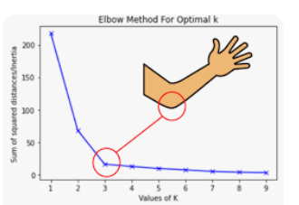
Elbow method
The elbow method is a technique used to determine the optimal number of clusters (K) in a K-means clustering algorithm.
It involves running the K-means algorithm for a range of K values and plotting the sum of squared distances (SSD) between data points and their assigned cluster centroids for each K.
The "elbow" of the plot, where the SSD starts to decrease at a slower rate, is considered a good estimate for the optimal number of clusters.

Slide 37
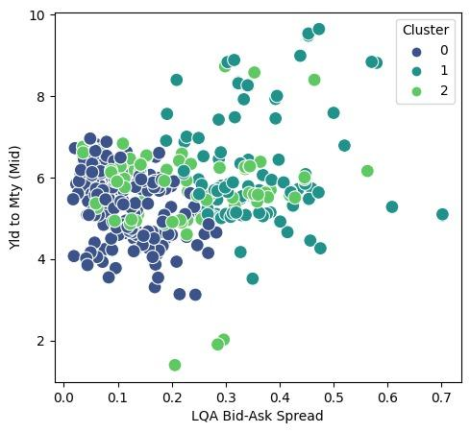
Visualizations
Higher Liquidity: A lower bid-ask spread is often associated with higher market liquidity. It means that there is less difference between the highest price a buyer is willing to pay (bid) and the lowest price a seller is willing to accept (ask). This can attract more market participants, making it easier for investors to buy or sell securities without a significant impact on the price.
Investor Confidence: A cluster with low bid-ask spreads may suggest a market where investors are confident in the availability of buyers and sellers. It could be a reflection of a well-functioning and liquid market.

Slide 38
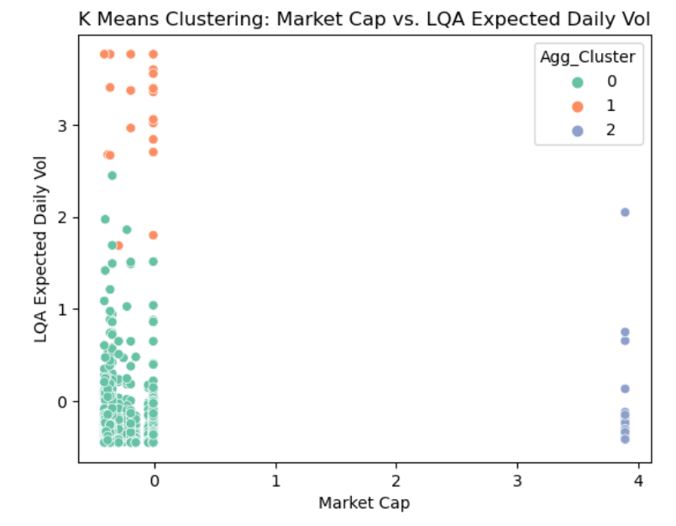
Visualizations
It suggests that the majority of securities with low market capitalization have lower expected daily trading volumes, indicating lower liquidity.
The clusters visually represent two distinct groups with low market capitalization, it implies that the data is more consented in the low market cap.

Slide 39
Inferences
Segmentation of Securities:
Clustering identifies distinct groups of securities with shared liquidity characteristics.
Liquidity Profiles:
Different clusters reveal varying levels of liquidity, from highly liquid securities with narrow spreads to less liquid options with wider spreads.
Dynamic Market Conditions:
Continuous monitoring of clusters captures dynamic market conditions, allowing market participants to adapt strategies based on evolving liquidity patterns.

Slide 40
THANK YOU

Slide 41
GITHUB REPOSITORY
GITHUB & SOURCES
https://github.com/jainayushee/market-liquidity-clustering
SOURCES
“K means clustering” - Dayanithi published on Level Up coding -
https://levelup.gitconnected.com/k-means-clustering-2534050a9b12abs.
Liu, Ze, et al. “SWIN Transformer: Hierarchical Vision Transformer Using Shifted Windows.” ArXiv.org, 17 Aug. 2021,
https://arxiv.org/abs/2103.14030v2.
McElreath, Richard. “Chapter 7: Ulysses' Compass.” Statistical Rethinking: A Bayesian Course with Examples in R and Stan Second Edition, CRC Press, Boca Raton, 2020, pp. 190–195.
Understanding Liquidity and How to Measure It (investopedia.com)
What are Financial Securities? Examples, Types, Regulation, and Importance(investopedia.com)
Security (finance) (wikipedia)
23

